Slide 1
Inter Process Communication
REFERENCES:
OPERATING SYSTEM CONCEPTS” 9TH EDITION BY ABRAHAM SILBERSCHATZ, PETER BAER GALVIN AND GREG GAGNE
OPERATING SYSTEMS: INTERNALS AND DESIGN PRINCIPLES”, 7TH EDITION BY WILLIAM STALLINGS

Slide 2
Overview
Background
The Critical-Section Problem
Peterson’s Solution
Synchronization Hardware

Slide 3
Background
Processes can execute concurrently
These may be interrupted at any moment of time, even they are partially completing execution.
Data inconsistency may occur in concurrent access to shared data.
A mechanisms is required to maintain data consistency to ensure the orderly execution of cooperating processes.

Slide 4
Producer
while (true) {
/* produce an item in next produced */
while (counter == BUFFER_SIZE) ;
/* do nothing */
buffer[in] = next_produced; in = (in + 1) % BUFFER_SIZE;
counter++;
}
Source : Operating Systems Concepts By Silberschatz & Galvin

Slide 5
Consumer
while (true) {
while (counter == 0)
; /* do nothing */ next_consumed = buffer[out]; out = (out + 1) % BUFFER_SIZE;
counter--;
/* consume the item in next consumed */
}
Source : Operating Systems Concepts By Silberschatz & Galvin

Slide 6
Race Condition
counter++ could be implemented as
register1 = counter register1 = register1 + 1 counter = register1
counter-- could be implemented as
register2 = counter register2 = register2 - 1 counter = register2
Consider this execution interleaving with “count = 5” initially: S0: producer execute register1 = counter
S1: producer execute register1 = register1 + 1
S2: consumer execute register2 = counter
S3: consumer execute register2 = register2 – 1
S4: producer execute counter = register1
S5: consumer execute counter = register2
{register1 = 5}
{register1 = 6}
{register2 = 5}
{register2 = 4}
{counter = 6 }
{counter = 4}
Source : Operating Systems Concepts By Silberschatz & Galvin

Slide 7
Critical Section Problem
Let assume that there are n processes {p₀, p₁, … p_{n-1}}
Each process has critical section segment of code
Processes may be change common variables, updates table, write into file, etc
When one process in critical section, no other processes are allowed to enter in its critical section for execution.
Critical section problem is to design an algorithm so that processes can cooperate.
Each process must take permission to enter in its critical section.

Slide 8
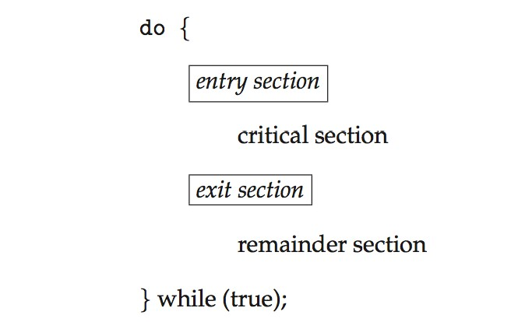
Critical Section
General structure of process P_{i}
Source : Operating Systems Concepts By Silberschatz & Galvin

Slide 9
Algorithm for Process P_{i}
do {
while (turn == j);
critical section
turn = j;
remainder section
} while (true);
Source : Operating Systems Concepts By Silberschatz & Galvin

Slide 10
Solution to Critical-Section Problem
Mutual Exclusion
Progress
Bounded Waiting

Slide 11
Critical-Section Handling in OS
Two approaches depending on if kernel is preemptive or non-preemptive
Preemptive: allows preemption of process
Non-preemptive: runs until exits kernel mode

Slide 12
Peterson’s Solution
A good solution for two processes
Assume that the load and store machine-language instructions are atomic
The two processes share two variables:
int turn;
Boolean flag[2]
The variable turn represents whose turn it is to enter the critical section
The flag array is used to indicate if a process is ready to enter the critical section.
flag[i] = true denotes that process P_{i} is ready to enter in critical section.

Slide 13
Algorithm for Process P_{i}
do {
flag[i] = true;
turn = j;
while (flag[j] && turn = = j);
critical section
flag[i] = false;
remainder section
} while (true);
Source : Operating Systems Concepts By Silberschatz & Galvin

Slide 14
Peterson’s Solution (Cont.)
Provable that the three CS requirement are met:
Mutual exclusion is preserved
P_{i} enters CS only if:
either flag[j] = false or turn = i
Progress requirement is satisfied
Bounded-waiting requirement is met

Slide 15
Synchronization Hardware
There are various systems that provide hardware support for implementing the critical section code.
All solutions are based on idea of locking
Protecting critical regions via locks
Uniprocessors – could disable interrupts
Currently running code would execute without preemption
Generally too inefficient on multiprocessor systems
 Operating systems using this not broadly scalable

Slide 16
Modern machines provide special atomic hardware instructions
 Atomic = non-interruptible
Either test memory word and set value
Or swap contents of two memory words

Slide 17
Solution to Critical-section Problem Using Locks
do {
acquire lock
critical section
release lock
remainder section
} while (TRUE);
Source : Operating Systems Concepts By Silberschatz & Galvin

Slide 18
test_and_set Instruction
Definition:
boolean test_and_set (boolean *target)
{
boolean rv = *target;
*target = TRUE; return rv:
}
Executed atomically
Returns the original value of passed parameter
Set the new value of passed parameter to “TRUE”.
Source : Operating Systems Concepts By Silberschatz & Galvin

Slide 19
Solution using test_and_set()
Shared Boolean variable lock, initialized to FALSE
Solution:
do {
while (test_and_set(&lock))
; /* do nothing */
/* critical section */ lock = false;
/* remainder section */
} while (true);
Source : Operating Systems Concepts By Silberschatz & Galvin

Slide 20
compare_and_swap Instruction
Definition:
int compare _and_swap(int *value, int expected, int new_value) { int temp = *value;
if (*value == expected)
*value = new_value; return temp;
}
Executed atomically
Returns the original value of passed parameter “value”
Source : Operating Systems Concepts By Silberschatz & Galvin

Slide 21
Solution using compare_and_swap
Shared integer “lock” initialized to 0;
Solution:
do {
while (compare_and_swap(&lock, 0, 1) != 0)
; /* do nothing */
/* critical section */ lock = 0;
/* remainder section */
} while (true);
Source : Operating Systems Concepts By Silberschatz & Galvin

Slide 22
Bounded-waiting Mutual Exclusion with test_and_set
do {
waiting[i] = true; key = true;
while (waiting[i] && key)
key = test_and_set(&lock); waiting[i] = false;
/* critical section */ j = (i + 1) % n;
while ((j != i) && !waiting[j]) j = (j + 1) % n;
if (j == i)
lock = false; else
waiting[j] = false;
/* remainder section */
} while (true);
Source : Operating Systems Concepts By Silberschatz & Galvin

